Slide 1
Does Housing Supply
Constrain Home Prices?
Evidence from 530 U.S. metros, 2019 - 2024.
Group 5
Tessa Butler, Siya Kumar, Naman Keswani, Ania Ting, & Shunji Lewandowski

Slide 2
Section 01
Question
01
and Motivation
Tessa Butler

Slide 3
Motivation
Our main research question: We plan to see if the supply-demand theory applies to housing supply and home prices by determining whether regions with lower housing supply experience higher home prices.
Why is this important? This research is essential to understanding housing supply and demand, which in turn can help populations develope more affordable and sustainable housing options.
Housing is the single biggest line item in most American budgets.
Homelessness hit a record high in 2024 and the country is short an estimated four million homes.
If building more homes lowers prices, permit reform is a direct policy implication.
771K
4M+
People homeless in 2024
National housing shortfall
22M
90%
Cost-burdened renters
Metros where prices beat wages

Slide 4
Prior Research
Glaeser–Gyourko–Saks (2005) and Saiz (2010) found that supply-tight metros had higher, more volatile prices.
Wooldridge warned that regressing prices on quantities flips sign when both respond to the same demand shock.
Prior work was mostly cross-sectional or city-level — our contribution was a multi-year panel of every U.S. metro.

Slide 5
Research Question
Did metros that issued more building permits see lower home prices, with income and population held fixed?
Standard supply-and-demand theory predicted a negative sign on permits.
We tested this across 530 metros and 5 years.
Model
log(HPI) = β₀ + β₁·log(Permits) + ε
Hypotheses
H₀: β₁ = 0
H₁: β₁ < 0
Expected sign
β₁ < 0

Slide 6
Section 02
Data
02
and Design
Naman Keswani & Siya Kumar

Slide 7
The Data
WHO | U.S. Metropolitan Statistical Areas (CBSAs), reported by the Census Bureau
WHAT | FHFA house-price index + Census building permits + American Community Survey Income and population
WHEN | Annual data, 2019 to 2024 (2020 was dropped from our dataset)
WHERE | 530 metros that appeared in all three sources, across every region
WHY | Housing is fundamentally local, so a metro-year panel gave us the variation we needed

Slide 8
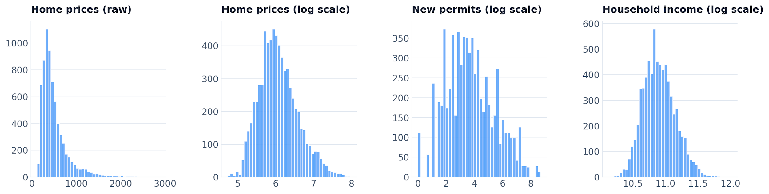
Variables
We used the log of the Federal Housing Finance Agency home-price index as our outcome, because raw prices were skewed by expensive coastal metros.
Our main regressor was the log of permits plus one, so that metros reporting zero permits in a year stayed in the sample.
We controlled for income, population, a central-metro indicator, and a dummy for every year to absorb national shocks.
Both sides of the equation were in logs, so each coefficient read as a percent change in prices per percent change in the variable.

Slide 9
Regressors
log Permits
More units → lower prices. Expected sign: negative.
Supply side.
log Income
Higher-income metros can pay more. Expected sign: positive, large.
Demand side.
log Population
More buyers competing for stock. Expected sign: positive.
Market size.
Metro dummy
Central metros command a premium. Expected sign: positive.
Central vs. outer.
Year dummies
Soaked up mortgage-rate cycles and recessions.
National shocks.
Notes:
The variables that we’ve chosen to use in our regression include permits, income, population, dummy and years. We’ve chosen to log the permits, income and population to reduce the non-linearity of the variables. According to our data, the TKTK explain slide.

Slide 10
Omitted Variables
Zoning strictness — pushes prices up and permits down, but uniform data measure exists.
Buildable-land share — cross-sectional data; hard to consider in our research
Mortgage rates — move demand year-by-year, absorbed by our year dummies.
These omissions were exactly the source of bias we had to take seriously.
Notes:
Some of the variables that we chose to omit include. We largely chose to not include these because the acquiring data to depict these variables is very hard like for zoning laws or buildable-land share. We chose not to include mortgage rates because a lot of the variance in that variable is absorbed by the year dummy variable.

Slide 11
Section 03
Analysis
03
and Execution
Shunji Lewandowski

Slide 12
Nested Models
Model 1 — permits only.
log(Permits) only.
Baseline: does supply correlate with prices at all?
Model 2 — added metro indicator and year dummies.
Add metro dummy + 4 year dummies.
Absorbs national price swings and metro vs micro differences.
Model 3 — added income and population.
All estimated by OLS with robust standard errors.
Add log(Income) + log(Population).
Controls for demand — isolates pure supply effect.
Model 1
log(HPI) = β₀ + β₁·log(Perm) + ε
Model 2
… + γ·Metro + Σ δₜ·Yearₜ
Model 3
… + λ·log(Inc) + μ·log(Pop)

Slide 13
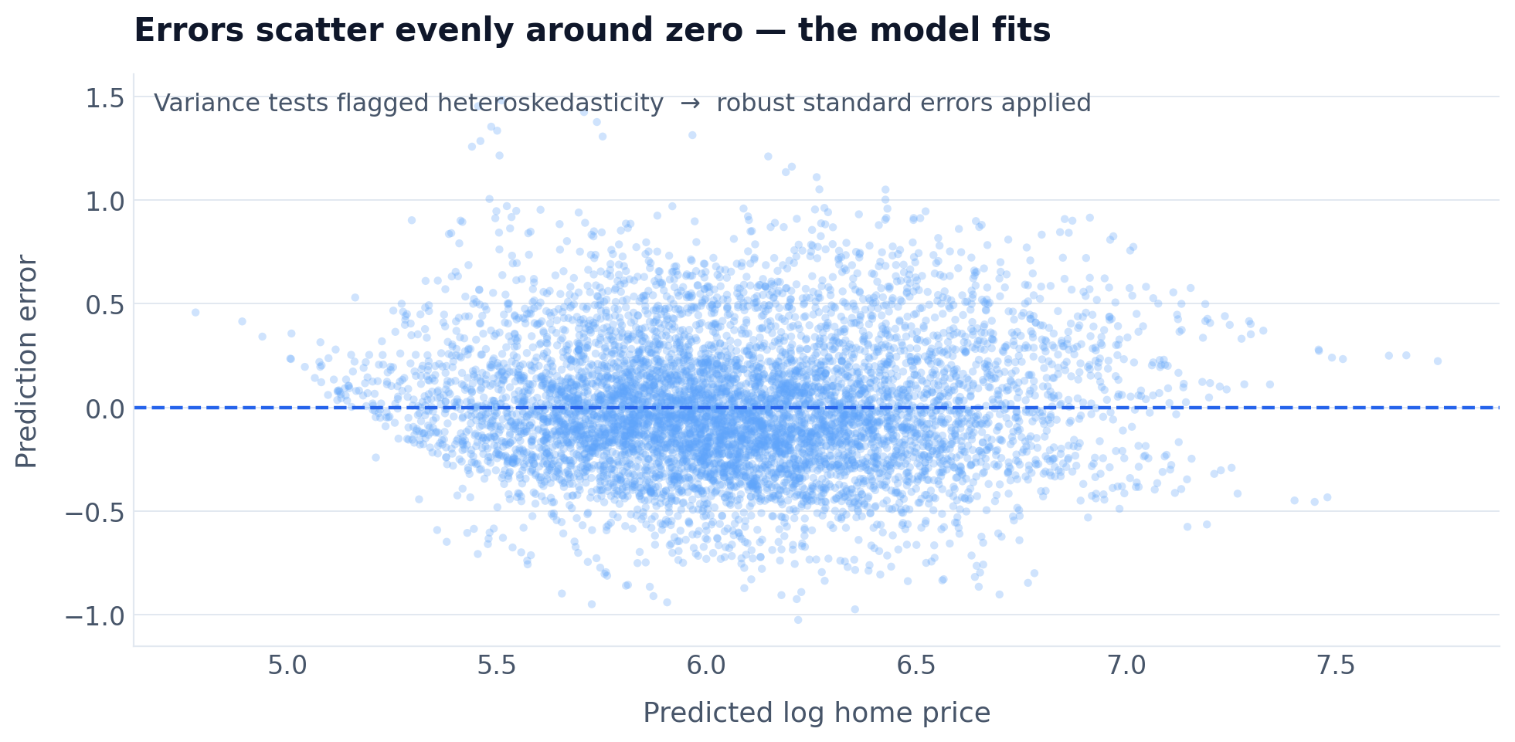
Diagnostics
Breusch–Pagan and White tests (Heteroskedasticity)
rejected constant variance → we reported robust SEs.
Residuals scattered evenly around zero — log–log was well specified.
F-Test (Joint Significance) - Year dummies were jointly significant.
All VIFs below 5 — no multicollinearity between income and population
Rule of thumb: VIF > 10 = problematic multicollinearity Our Max VIF = 4.34 → OK

Slide 14
Section 04
Interpretation
04
and Insight
Ania Ting

Slide 15
Results
Regressor | Model 1 | Model 2 | Model 3
log Permits (β₁) | +0.1494*** (0.0056) | +0.1448*** (0.0056) | +0.0809*** (0.0084)
log Income | — | — | +1.5609*** (0.0472)
log Population | — | — | +0.0279*** (0.0121)
Metro dummy | — | +0.2365*** (0.0124) | +0.1186*** (0.0114)
Year fixed effects | No | Yes | Yes
Constant | +5.6172 (0.0128) | +5.3390 (0.0195) | −11.1421 (0.2544)
R² | 0.221 | 0.301 | 0.557
Observations | 2036 | 2036 | 2036
Robust SEs in parentheses. ***p<0.01. β₁ shrank from +0.12 to +0.04 — but never turned negative.

Slide 16
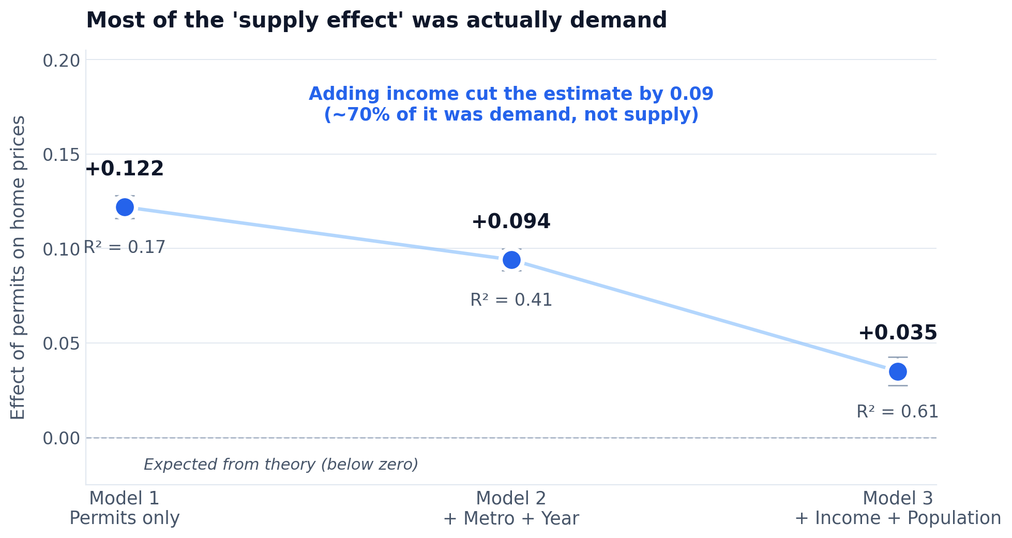
OVB Shrinkage
β₁ dropped from +0.15 to +0.08 once income entered.
Income's own coefficient was +1.56 — demand was doing the work.
OLS had labeled a demand correlation as a supply effect.
β₁ fell from +0.149 to +0.081 — roughly 46% of the initial estimate was demand, not supply.

Slide 17
Robustness
Dropping zero-permit metros → β₁ = +0.082.
Trimming extreme permit values → β₁ = +0.074.
Using yearly price change instead → β₁ = +0.827 (same sign).
Sign and significance held everywhere.
The estimate was stable — no specification rescued a negative sign.

Slide 18
Reverse Causality
Developers build where prices are highest — so permits respond to prices, not the other way around.
Income's +1.56 coefficient confirmed demand was the dominant force.
Without an instrument, OLS can't separate supply from demand.
Saiz's buildable-land share is a credible instrument for future work.
Our β₁ ≈ +0.081 → a correlation, not a causal supply effect.

Slide 19
Conclusion
Approach
A 5--year panel of 530 U.S. metros, three nested OLS models with robust SEs.
Findings
β₁ stayed positive in every spec — +0.15 → +0.08 after controls — never negative.
Caveats
OLS couldn't separate supply from demand; zoning and buildable land were unobservable.
Future work
Instrument permits with geographic or regulatory constraints (Saiz; Glaeser–Gyourko).

Slide 20
References
Data
FHFA. All-Transactions House Price Index at the CBSA level, 2019–2024.
Data
U.S. Census Bureau. Building Permits Survey, CBSA monthly file (January 2026 release).
Data
U.S. Census Bureau. American Community Survey 1-Year tables B19013, B25001, B01003, 2019–2024.
Data
U.S. Department of Housing and Urban Development. 2024 Annual Homeless Assessment Report to Congress.
Academic
Glaeser, E., Gyourko, J., & Saks, R. (2005). Why is Manhattan so Expensive? Regulation and the Rise in Housing Prices. Journal of Law and Economics, 48(2).
Academic
Saiz, A. (2010). The Geographic Determinants of Housing Supply. Quarterly Journal of Economics, 125(3).
Academic
Joint Center for Housing Studies of Harvard University. The State of the Nation's Housing (2024).
Textbook
Wooldridge, J. M. (2019). Introductory Econometrics: A Modern Approach, 7th ed. Cengage.

